Slide 1
Mini Project 2: Scale-space blob detection

Slide 2
Introduction:
In computer vision, blob detection methods are aimed at detecting regions in a digital image that differ in properties, such as brightness or colour, compared to surrounding regions. Informally, a blob is a region of an image in which some properties are constant or approximately constant; all the points in a blob can be considered in some sense to be similar to each other. The most common method for blob detection is convolution.

Slide 3
Steps through implementation :
Generate a Laplacian of Gaussian filter.
Build a Laplacian scale space, starting with some initial scale and going for n iterations:
Filter image with scale-normalized Laplacian at current scale.
Save square of Laplacian response for current level of scale space.
Increase scale by a factor k.
Perform nonminimum suppression in scale space.
Display resulting circles at their characteristic scales.

Slide 4
1. Laplacian blob detector:{Up Sampling}
Algorithm steps:
Import image.
convert it to gray
convert it to double
Perform LoG filter to image for several levels
tic
for i = 1:levels
Generate a Laplacian of Gaussian filter
Filter the img with LoG
Increase scale by a factor k
end
toc

Slide 5
nonminimum suppression
for i = 1:levels
% replaces each element by the orderth element in the sorted set of
neighbors by ordfit2.
end
for i = 1:levels
survive_space = scale_space.* img;
end
Find all the coordinates and corresponding sigma
for num = 1:levels
% Find index and corresponding radius
end
show_all_circles

Slide 6
2. Laplacian blob detector:{Down Sampling}
Algorithm steps:
Import image.
convert it to gray
convert it to double
Perform LoG filter to image for several levels
tic
for i = 1:levels
% Generate a Laplacian of Gaussian filter
% Filter the img with LoG
% return the image to its original scale
% Increase scale by a factor k
% Downsample the img
end
toc

Slide 7
nonminimum suppression
for i = 1:levels
% replaces each element by the orderth element in the sorted set of
neighbors by ordfit2.
end
for i = 1:levels
survive_space = scale_space.* img;
end
Find all the coordinates and corresponding sigma
for num = 1:levels
% Find index and corresponding radius
end
show_all_circles

Slide 8
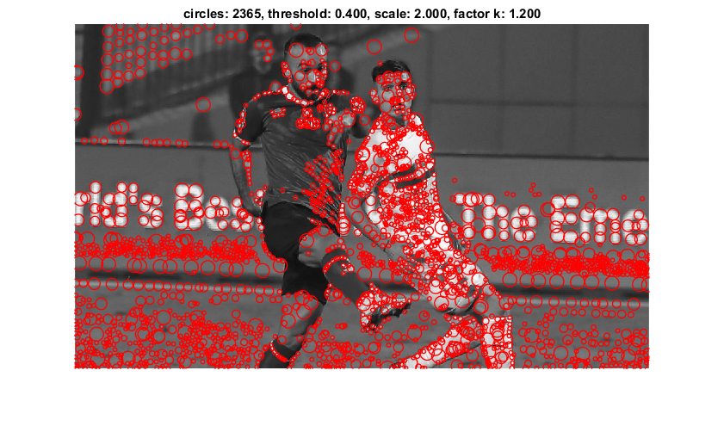

Results for Up Sampling:
Parameters: ● k = 1.2 ● scale = 2 ● threshold = 0.4 ● number of levels = 8
Elapsed time is 0.972935 seconds.

Slide 9
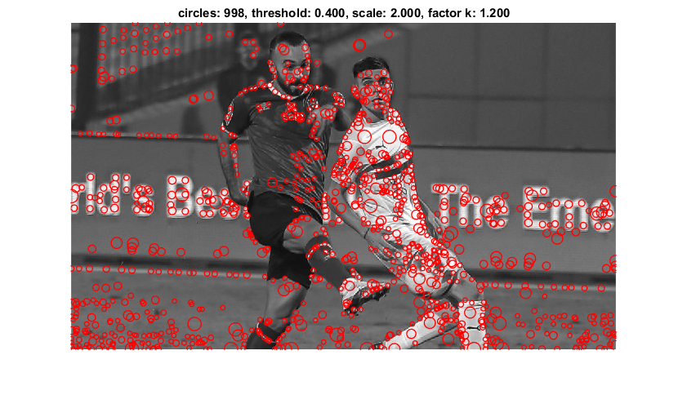
Results for Down Sampling:
Parameters: ● k = 1.2 ● scale = 2 ● threshold = 0.4 ● number of levels = 8
Elapsed time is 0.535349 seconds.

Slide 10
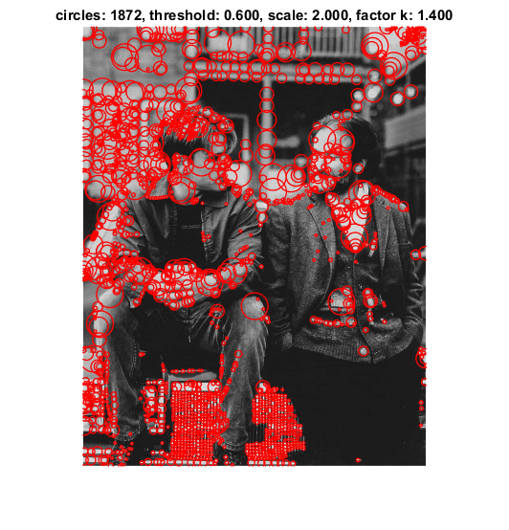
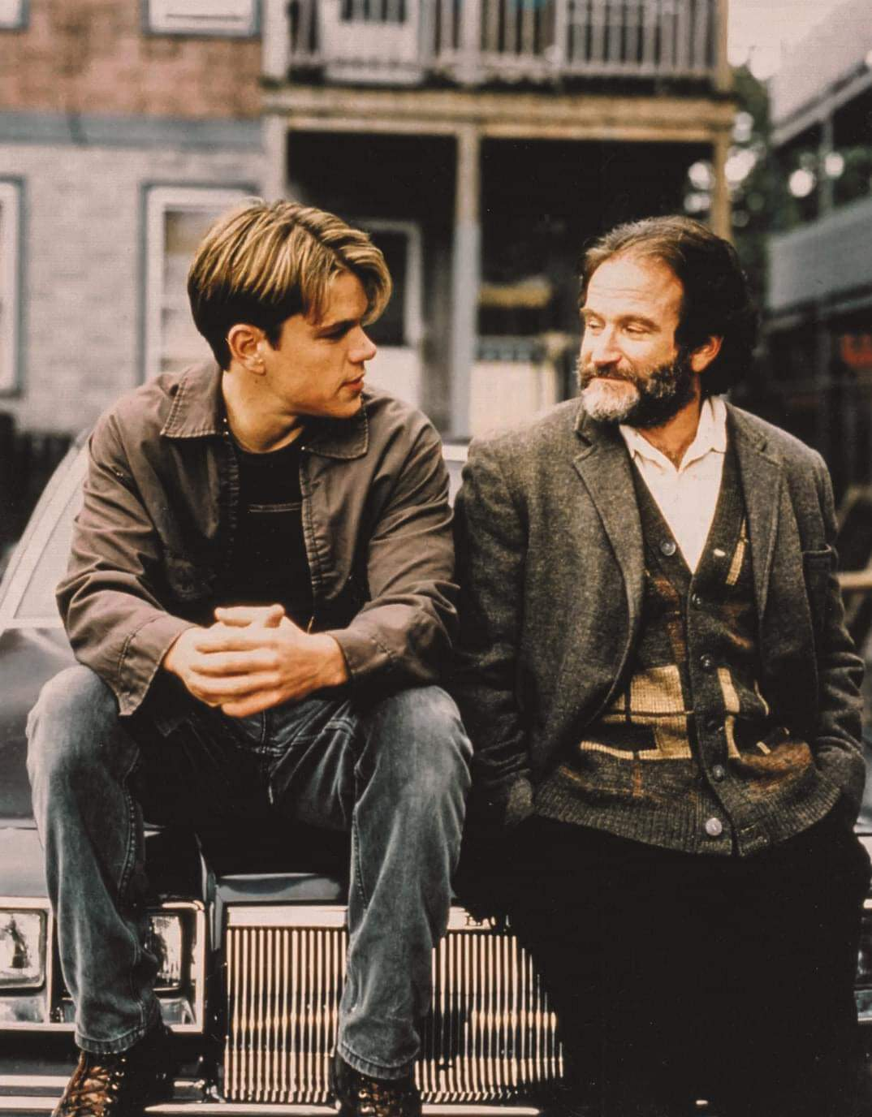
Results for Up Sampling:
Parameters: ● k = 1.4 ● scale = 2 ● threshold = 0.6 ● number of levels = 8
Elapsed time is 11.714062 seconds.

Slide 11
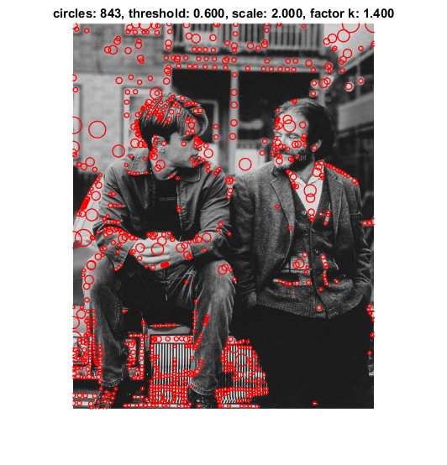
Results for Down Sampling:
Parameters: ● k = 1.4 ● scale = 2 ● threshold = 0.6 ● number of levels = 8
Elapsed time is 0.969546 seconds.

Slide 12
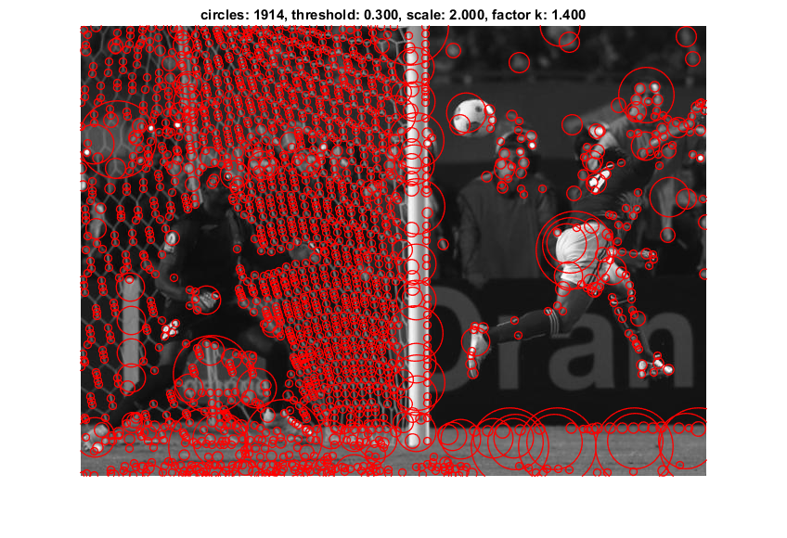
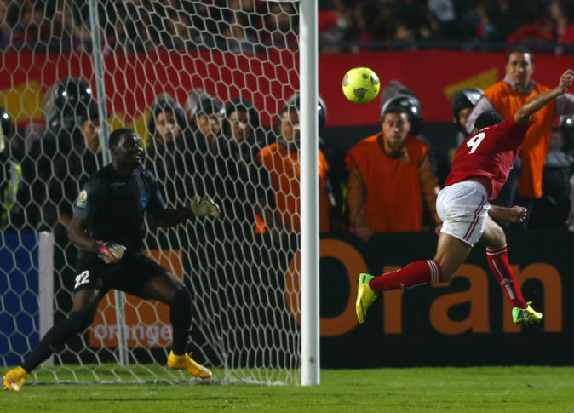
Results for Up Sampling:
Parameters: ● k = 1.4 ● scale = 2 ● threshold = 0.3 ● number of levels = 8
Elapsed time is 2.822294 seconds.

Slide 13
Results for Down Sampling:
Parameters: ● k = 1.4 ● scale = 2 ● threshold = 0.3 ● number of levels = 8
Elapsed time is 0.469494 seconds.

Slide 14
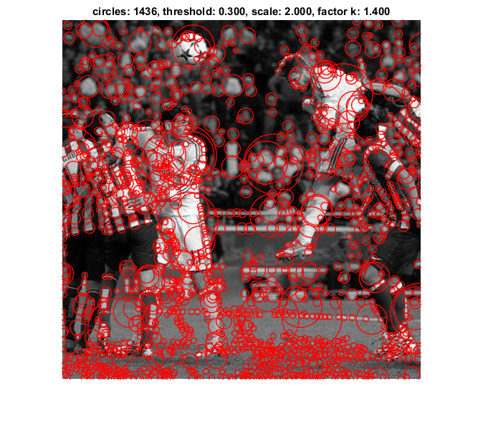
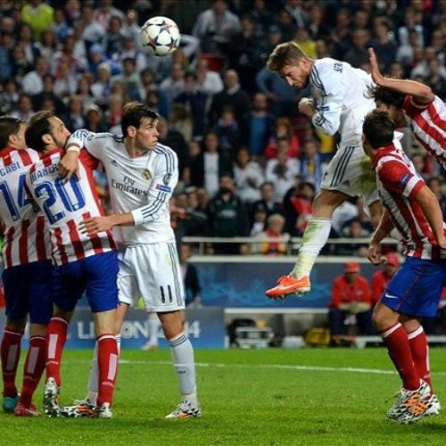
Results for Up Sampling:
Parameters: ● k = 1.4 ● scale = 2 ● threshold = 0.3 ● number of levels = 8
Elapsed time is 1.917761 seconds.

Slide 15
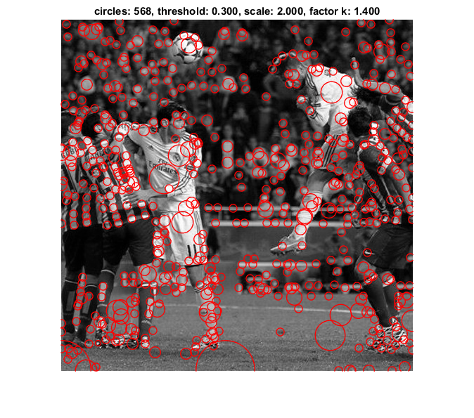
Results for Down Sampling:
Parameters: ● k = 1.4 ● scale = 2 ● threshold = 0.3 ● number of levels = 8
Elapsed time is 0.396899 seconds.

Slide 16
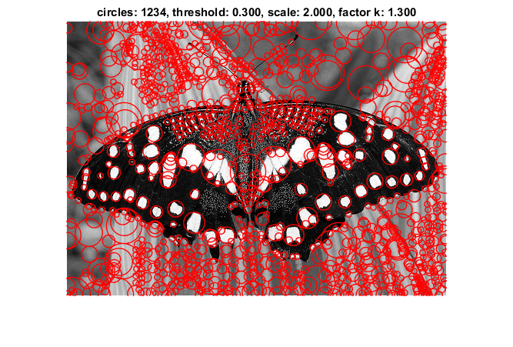
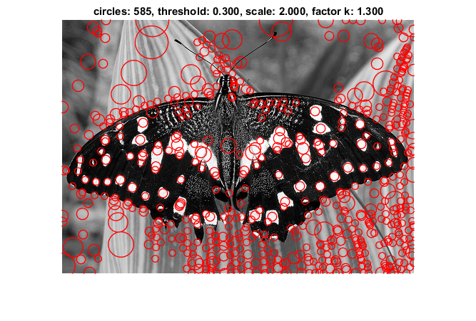
Up Sampling:
Down Sampling:
Parameters: ● k = 1.3 ● scale = 2 ● threshold = 0.3 ● number of levels = 8
Elapsed time is 0.686530 seconds.
Elapsed time is 0.363928 seconds.

Slide 17
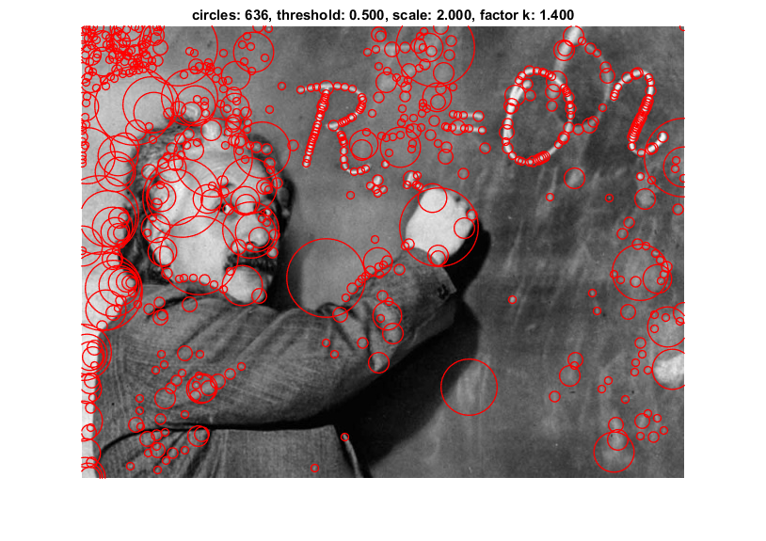
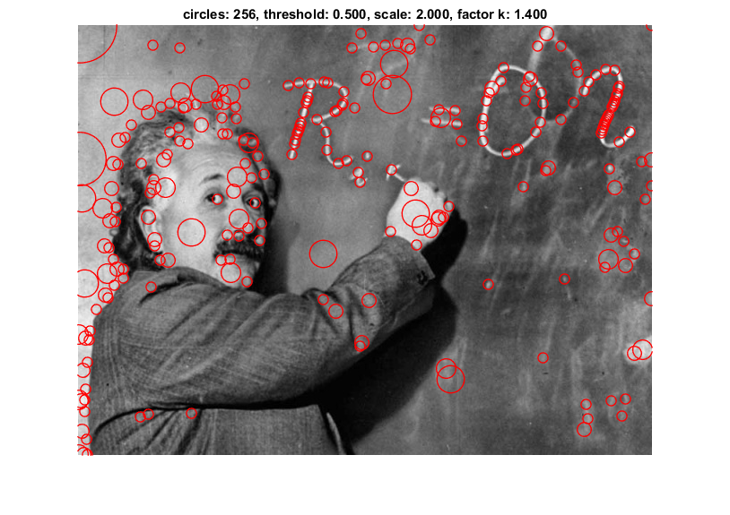
Up Sampling:
Down Sampling:
Parameters: ● k = 1.4 ● scale = 2 ● threshold = 0.5 ● number of levels = 8
Elapsed time is 2.545424 seconds.
Elapsed time is 0.454741 seconds.

Slide 18
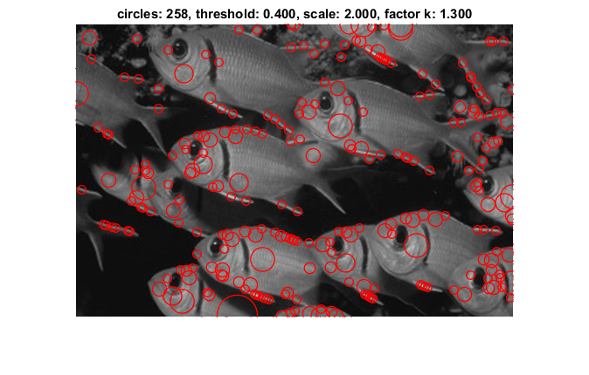

Up Sampling:
Down Sampling:
Parameters: ● k = 1.3 ● scale = 2 ● threshold = 0.4 ● number of levels = 8
Elapsed time is 0.919862 seconds.
Elapsed time is 0.327269 seconds.

Slide 19
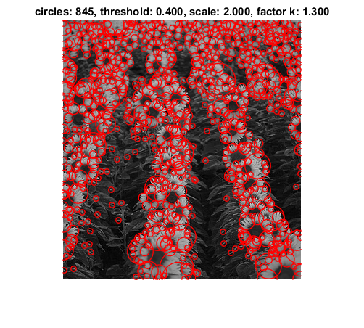
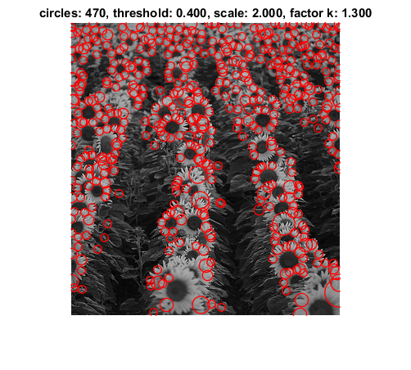
Up Sampling:
Down Sampling:
Parameters: ● k = 1.3 ● scale = 2 ● threshold = 0.4 ● number of levels = 8
Elapsed time is 0.656524 seconds.
Elapsed time is 0.346614 seconds.

Slide 20
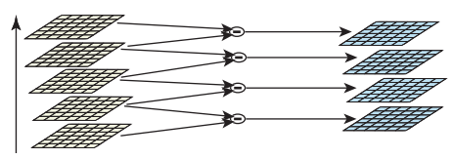
3. [BONUS POINT] Differences of Gaussian pyramid
Algorithm steps:
convert img to gray
convert it to double
Parameters initialization
First octave
tic
img_octave_1 = img;
for i = 1:levels
Generate a Laplacian of Gaussian filter
Filter the img with LoG
Increase scale by a factor k
end
Subtract the previous octave

Slide 21
Second octave
img_octave_2 = imresize(img, 0.5);
for i = 1:levels
End
Subtract the previous octave
Third octave
img_octave_3 = imresize(img_octave_2, 0.5);
for i = 1:levels
End
Subtract the previous octave
resize to original image
Apply threshold in each 2D slice.
Perform Nonmaximal Suppression in octaves
show_all_circles

Slide 22
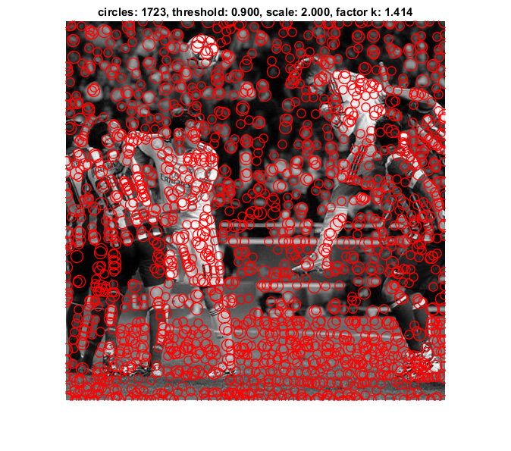
Results for Differences of Gaussian pyramid :
Parameters: ● k = 1.414 ● scale = 2 ● threshold = 0.9 ● number of levels = 8
Elapsed time is 0.326495 seconds.

Slide 23
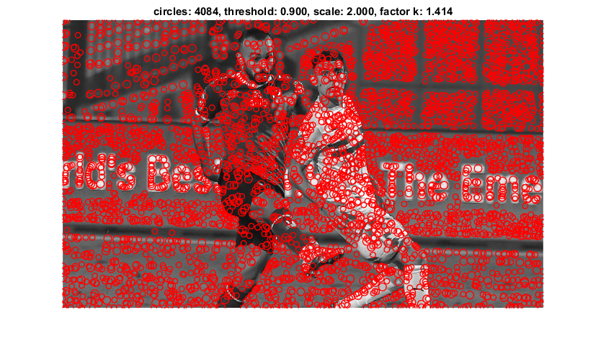
Results for Differences of Gaussian pyramid :
Parameters: ● k = 1.414 ● scale = 2 ● threshold = 0.9 ● number of levels = 8
Elapsed time is 0.478795 seconds.

Slide 24
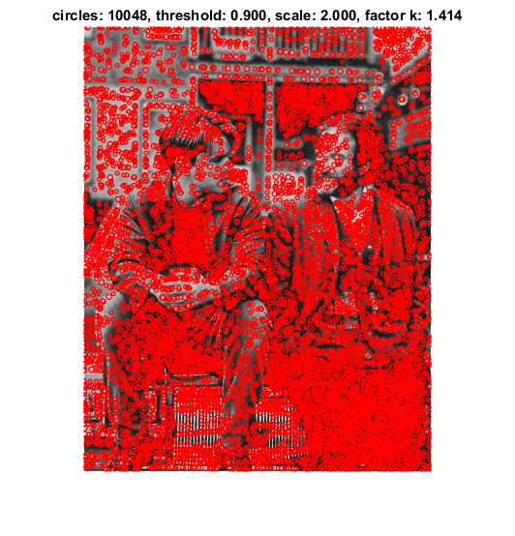
Results for Differences of Gaussian pyramid :
Parameters: ● k = 1.414 ● scale = 2 ● threshold = 0.9 ● number of levels = 8
Elapsed time is 0.878857 seconds.

Slide 25
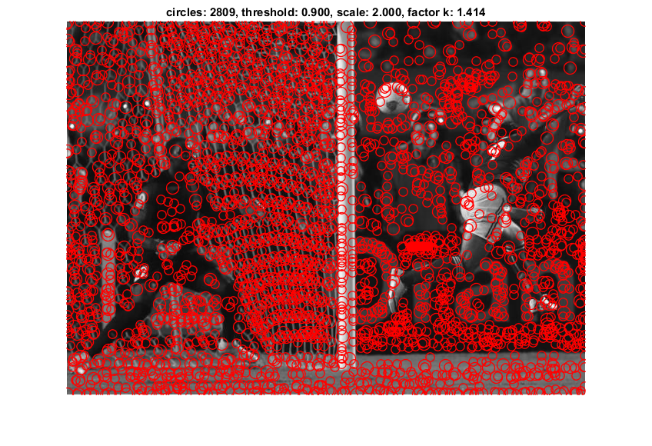
Results for Differences of Gaussian pyramid :
Parameters: ● k = 1.414 ● scale = 2 ● threshold = 0.9 ● number of levels = 8
Elapsed time is 0.338450 seconds.

Slide 26
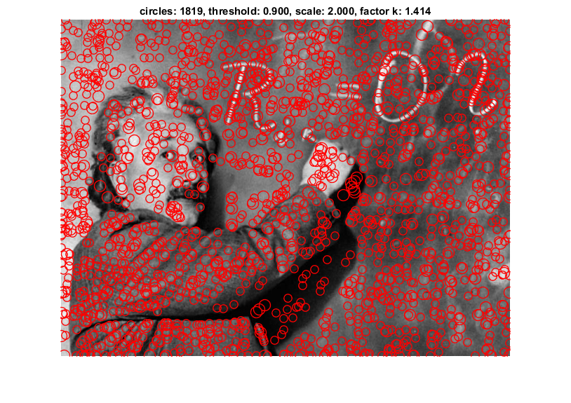
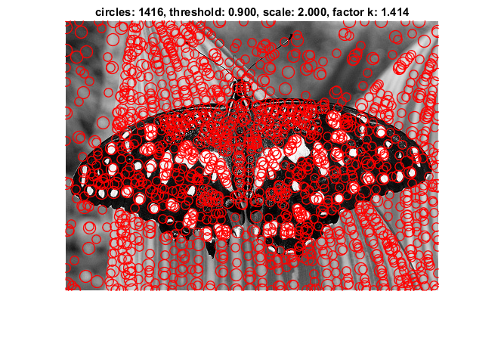

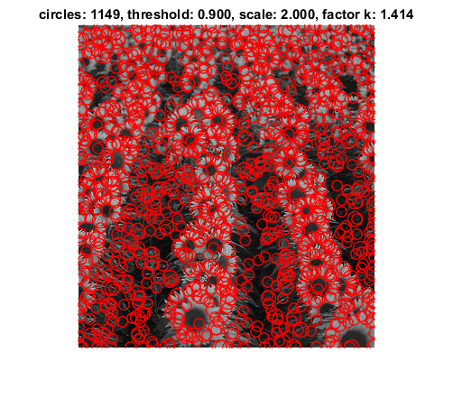
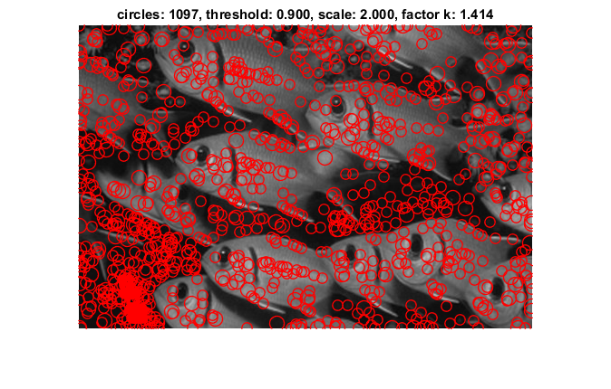
Parameters: ● k = 1.414 ● scale = 2 ● threshold = 0.9 ● number of levels = 8
Elapsed time is 0.311278 seconds.
Elapsed time is 0.369893 seconds.
Elapsed time is 0.277236 seconds.
Elapsed time is 0.313279 seconds.

Slide 27
Conculation :
We have explored how different the blob detection methods — such as the Laplacian of Gaussian (LoG), Difference of Gaussian (DoG), can be used to detect, label, and measure objects in our image. We have also tackled the importance of pre-processing the image before conducting such blob detection methods. Now, it should be noted that specific applications will require specific blob detection methods, and it is upon the discretion of the data scientist to choose the proper techniques. With this, I hope the findings raised in this blog can help you select the most appropriate blob detection method in your projects.

